Slide 1
CHARACTER RECOGNITION USING NEURAL NETWORKS
Presented By:
Akash Mohapatra
Sourav Chakraborty
Raja Mummidi
Lata Yadav
Notes:
10. 12:25 – 12:40 Character Recognition using Neural Networks, Akash Mohapatra, Sourav
Chakraborty, Raja Mummidi, Lata Yadav

Slide 2
Outline
Introduction to Character Recognition
Why using neural networks?
Proposed Model
Data Set Used for Character Recognition
Case Study
Backpropagation Algorithm
Feed-Forward Neural Network
Training of Neural Network
Performance Analysis
Graph Analysis
Where can we use Character Recognition?

Slide 3
Introduction
Character recognition, usually abbreviated to ‘Optical Character Recognition’ (OCR), is the mechanical or electronic conversion of images of typed, handwritten or printed text into machine-encoded text.
It is a field of research in pattern recognition, machine vision and artificial intelligence.
This is one of the most cost-effective and speedy method available for document-input task.
Notes:
Difference in font and sizes makes recognition task difficult.
Reusing scanned information to read and search content - challenging computation process (Speed of computing & Efficiency matter)

Slide 4
Why Neural Networks?
Human Mind – Decipher characters easily ,accurately & Speedily (Presence of densely Neural Networks in his mind)
Human Eyes - Optical Mechanism
Human Brain - Sees input – Comprehend signals – Adaptive to minor changes and errors in visual patterns
Human Vision System – learns from experience
Backpropagation artificial multi-layer neural network
Inspired by Biological nervous system : "just like the brain“.
Improve quality of recognition ( comparably high accuracy levels)
Efficient and fast in solving fuzzy, extremely complex problems that don't yield to traditional algorithmic approaches

Slide 5
Proposed Model
Recognition of English characters and variations from a sample set of patterns via ANN and Backpropagation algorithm (Implementation in MATLAB )
Performance analysis using various classification algorithms like KNN & Decision tree
Input Matrix
Data Set
Training
Artificial Neural Networks
Output
26 alphabets
Backpropagation Algorithm
Performance Analysis

Slide 6
Data Set Used for Character Recognition
Character Images
Character images from 20 different fonts for 26 alphabets of English language randomly distorted to produce 20,000 unique stimuli
Stimuli
16 primitive numerical attributes scaled to fit into a range of integer values from 0 through 15
Partitioning
Train on the first 16000 items and then use the resulting model to predict the letter category for the remaining 4000

Slide 7
Case Study : System Overview
Data Set
Post – Processing
Input
ANN Implementation
Output
Backpropagation Algorithm
Normalizing
Partitioning
Removing Noise
Create Neural Networks
Constructing input and target Matrix
Hidden layers and Neurons
Testing & Validating
Performance Analysis

Slide 8
Backpropagation Algorithm
Create a feed-forward network with n_{input} inputs , n_{hidden} hidden units and n_{output} units
Initialize all network weights to small random numbers
Repeat until termination condition
For each training example
Propagate the input forward through the network and compute the output
Propagate the errors backward through the network
For each network output unit, calculate its error term
For each hidden unit, calculate its error term
Update each network weight

Slide 9
Neural Network design process:
The work flow for the general neural network design process has seven primary steps:
Collect data
Create the network
Configure the network
Initialize the weights and biases
Train the network
Validate the network (post-training analysis)
Use the network

Slide 10
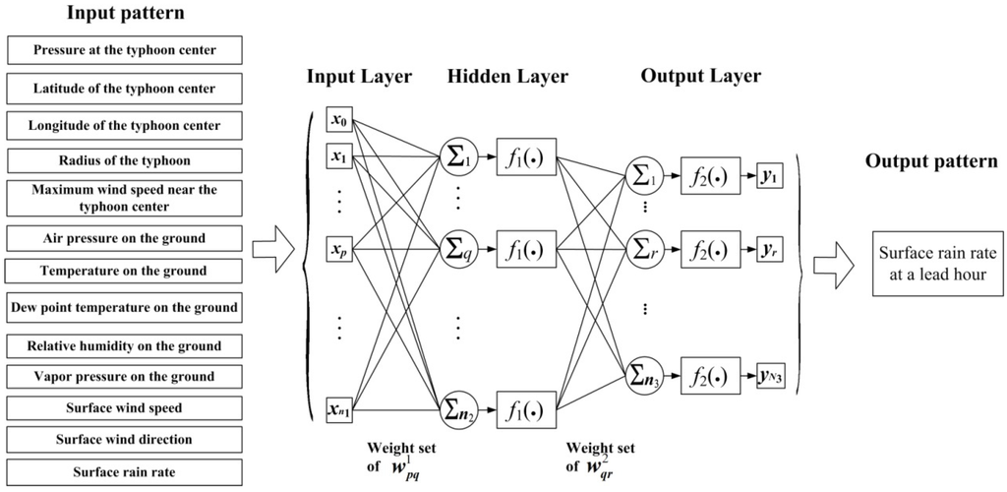
Feed-Forward Neural Network

Slide 11
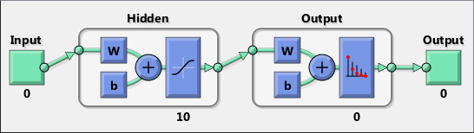
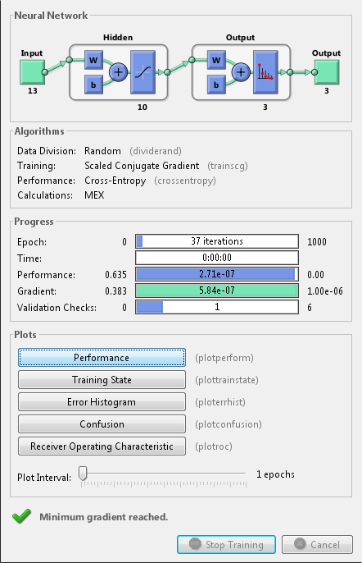
Training of Neural Network
Before Training
After Training
30
16
26
30
26
Notes:
Now the network is ready to be trained. The samples are automatically divided into training, validation and test sets. The training set is used to teach the network. Training continues as long as the network continues improving on the validation set. The test set provides a completely independent measure of network accuracy.
http://www.mathworks.com/help/nnet/examples/wine-classification.html

Slide 12
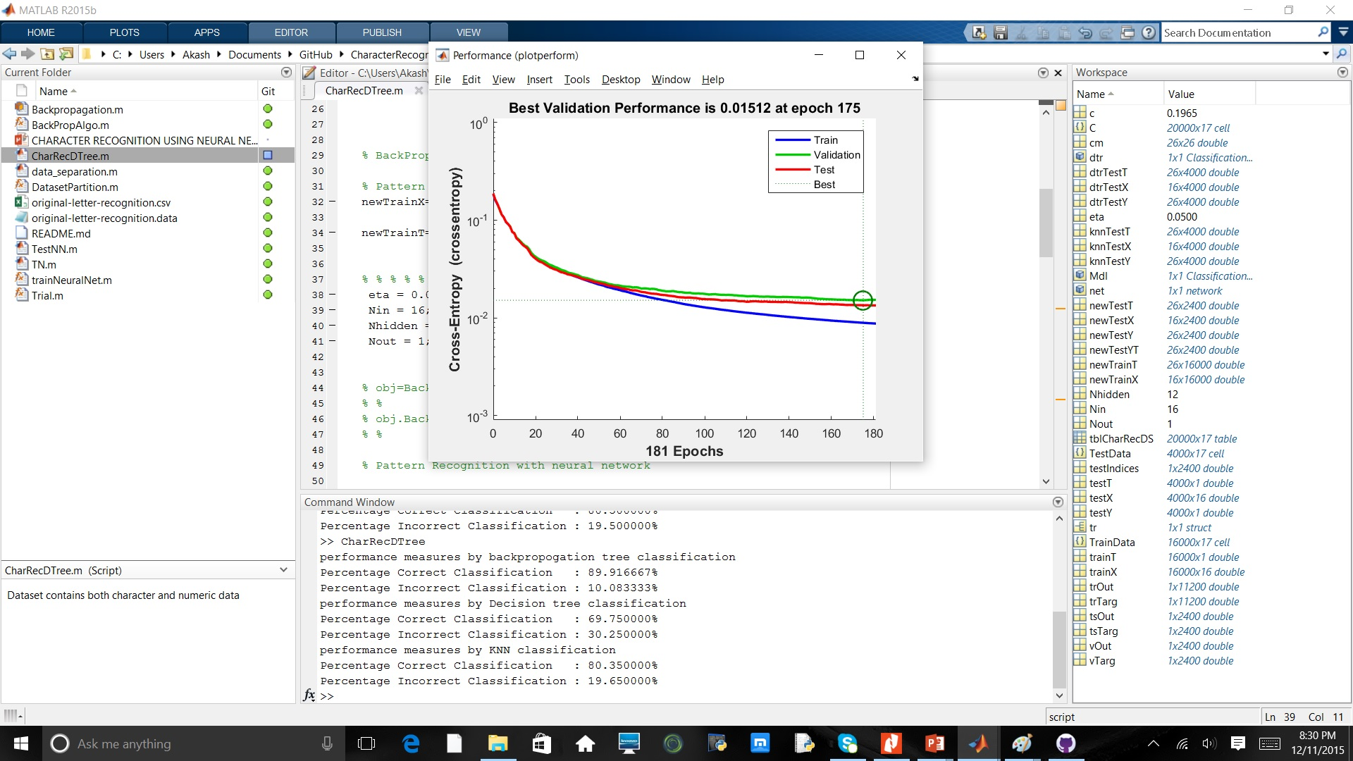
Performance Analysis

Slide 13
Comparison with different algorithms
Performance measures by backpropagation classification
Percentage Correct Classification : 88.375000%
Percentage Incorrect Classification : 11.625000%
Performance measures by Decision tree classification
Percentage Correct Classification : 71.050000%
Percentage Incorrect Classification : 28.950000%
Performance measures by KNN classification
Percentage Correct Classification : 81.175000%
Percentage Incorrect Classification : 18.825000%

Slide 14
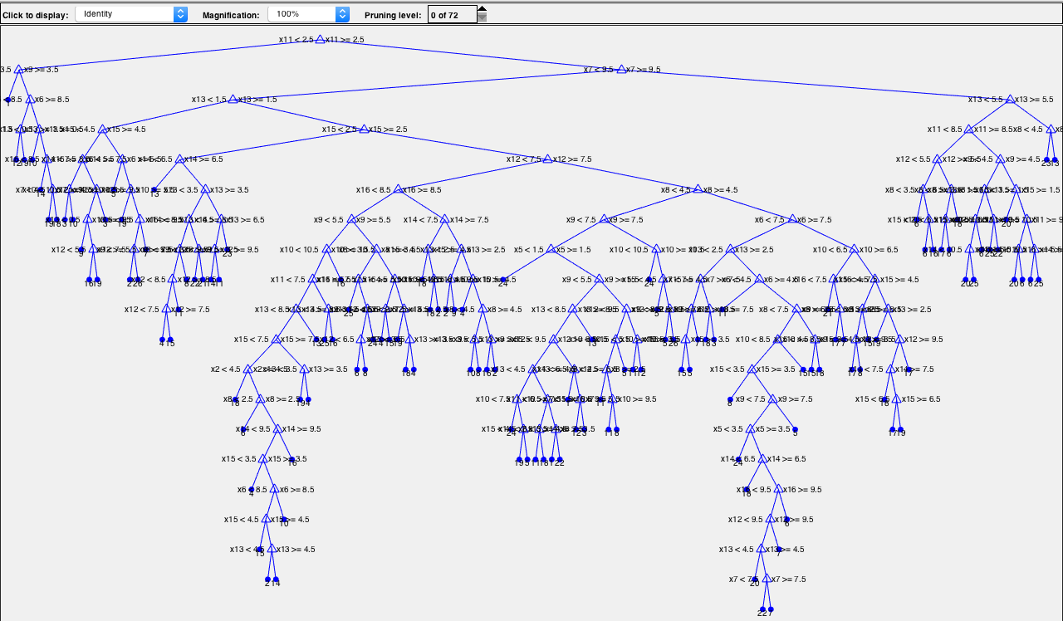
Decision Tree:

Slide 15
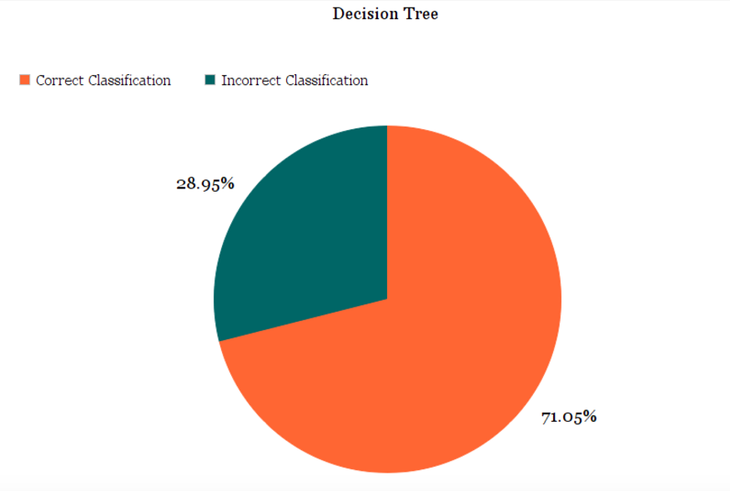
Graph Analysis:

Slide 16
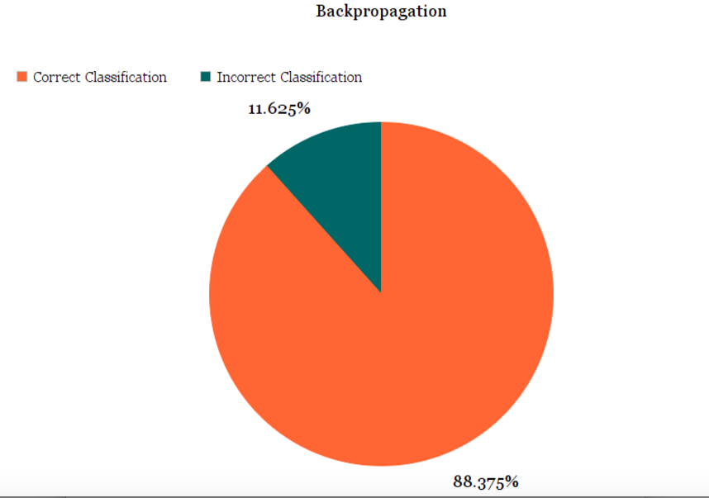
Graph Analysis:

Slide 17
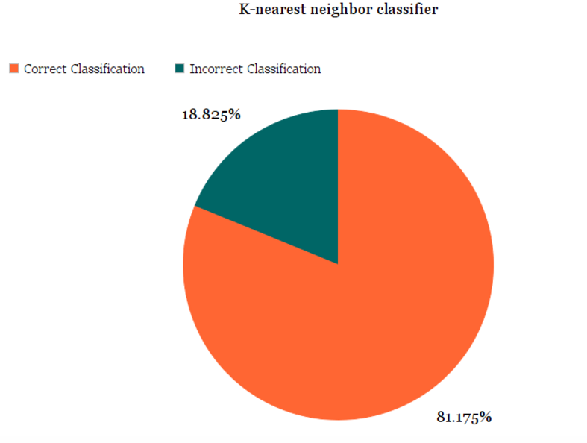
Graph Analysis:

Slide 18
Where can we use Character Recognition?
Data Entry (banking environment)
Text Entry (office automation)
Process automation (post office)
Automatic Number Plate Recognition
Extraction of information (Cards)
Pen computing - Converting handwriting in real time to control a computer
Assistive technology for blind and visually impaired users
Make electronic images of printed documents searchable (Google Books)

Slide 19


